Slide 1
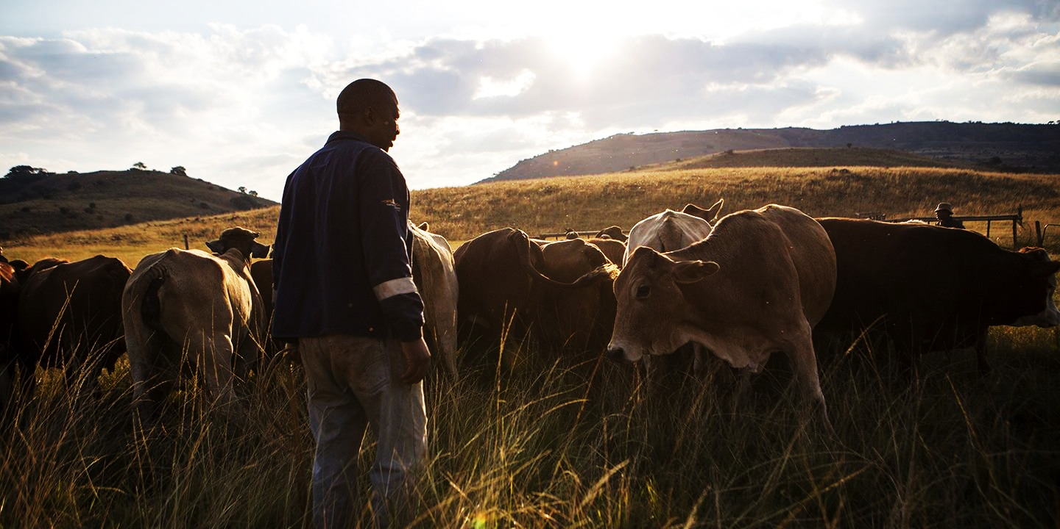
Enhancing the investment and export competitiveness of the Beef lndustry
Enhancing the Investment and Export Competitiveness of the Beef Industry
By Kgotso Kgosiemang

Slide 2
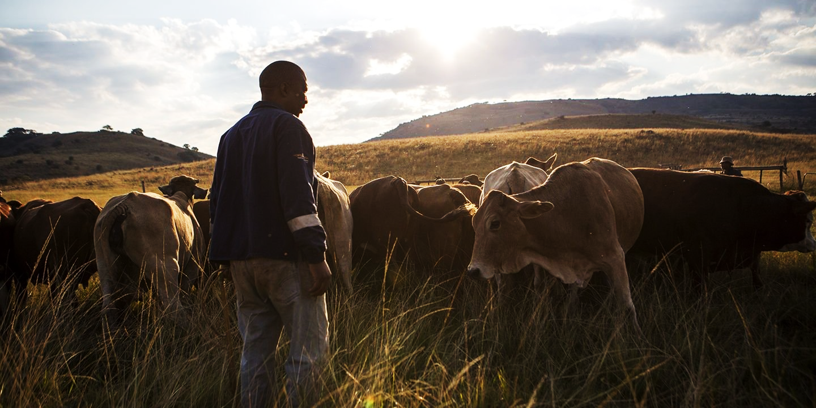
Botswana National Beef Producers Union (BNBPU)

Slide 3
Who is BNBPU?
BNBPU is the national coordinating and advocacy body
Registered with Registry of societies in 2013
Recognized by the farming community and the MoADFS as the legal representative of beef farmers in Botswana
BNBPU is made up of passionate farmers to serves and lobby on behalf of farmers
We are an entity that values and acknowledges the invaluable value of a cow in Batswana’s livelihoods. BNBPU recognizes cattle rearing as a vehicle towards the eradication of poverty in Botswana as well as bringing nutritional value to households in the country and the world over.
We help foster and nurture beneficial relations between industry stakeholders and farming community, in an effort to create a healthy dialogue between interested parties.
To encourage a robust and thriving beef industry that will bring values to the investments of the farming community
BNBPU exists to address issues facing the farming community in terms of farming conditions, market and encourage drive towards livestock improvement

Slide 4
Outputs of the Support Programme
The programme set out to benchmark on the best case privatization model to be adopted in the privatization of BMC using GPS Food Group and Nortura
The exercise provided a good learning curve on investments in the beef sector which have a beneficial impact on the producer
The model to give farmers control over BMC as BMC was originally establish as a farmer owned enterprise
Farmer owned BMC would be accountable to the farmers and motivate farmers to do more for their own enterprise
The programme recommended the cooperative model through which farmers can use to own BMC

Slide 5
While the assistance was ongoing, the BMC Act was changed rendering the proposed model unattainable
The New Act indicates that no one person can own more than 10% shareholding in BMC
However, discussions between government and BNBPU on the privatization of BMC ongoing

Slide 6
Trade and lnvestment Gains of transforming BMC into a Farmer Owned Company
It will be a motivation for the farmers to work hard and grow their own investment for a better return just like the Nortura model
It will foster an element of efficiency and effectiveness in the operations of the BMC for the benefit of the shareholder
It will be easier to incorporate market demands and requirements as the farmer is the owner and can easily cascade such market requirements to the farm

Slide 7
North-South cooperation led to a benchmark exercise in the beef sector at Nortura and GPS in order to build capacity in the BNBPU as a preparatory exercise for full participation in the privatisation of BMC
Good practise cases in established farmers’ formation a guidance to BNBPU’s own farmer formation

Slide 8
Limits of the Technical Assistance
k
Support ended along the way while privatisation is ongoing and yet to be completed
BNBPU still needs the support in order to foster capacity building and involve farmers to dictate their privatisation model to government
Further support needed to lobby all the farmers to rally behind their union and utilise their power to have a say in all matters relating to beef and policy

Slide 9
Way Forward
Seek further assistance for capacity building to enable farmers to be more involved in beef related matters
Alongside best practise models build a robust and self sustaining beef union which is responsive to the needs of farmers
Build an advocacy strategy that includes women and youth for a more evolving and sustainable beef industry

Slide 10
Questions and Comments

Slide 11
Thank you

